Slide 1




Polish
superstitions
Let's get to know Polish superstitions

Slide 2
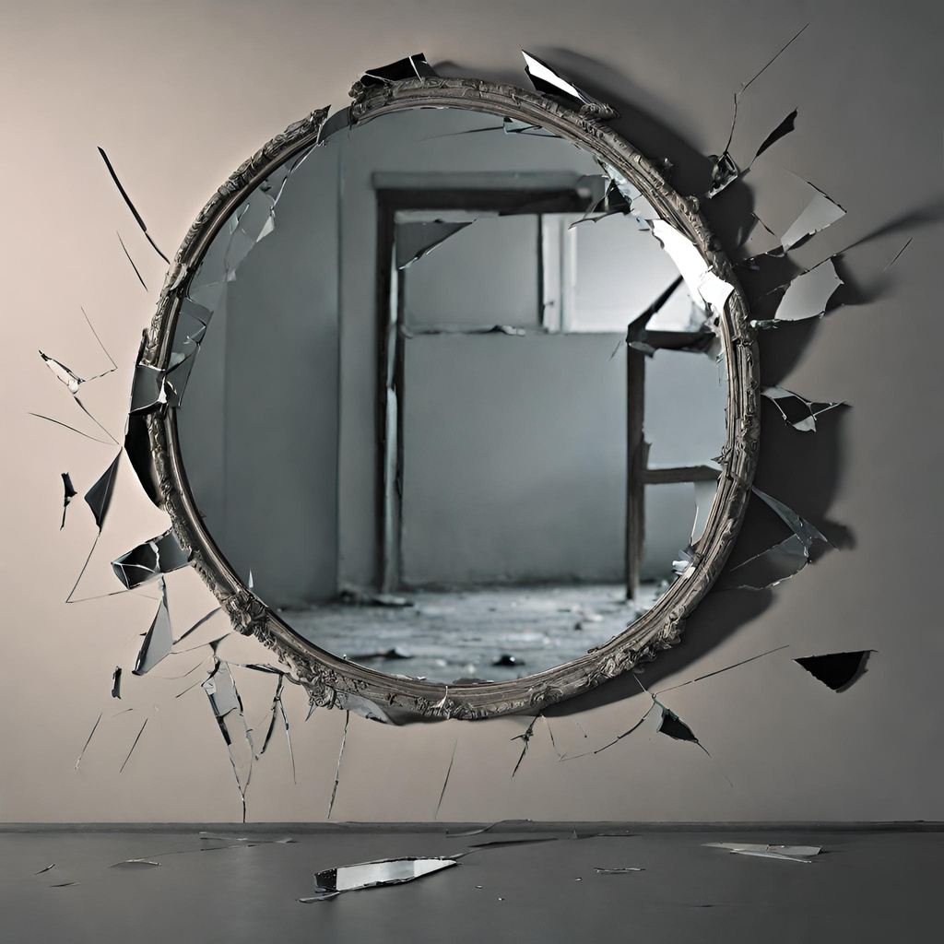
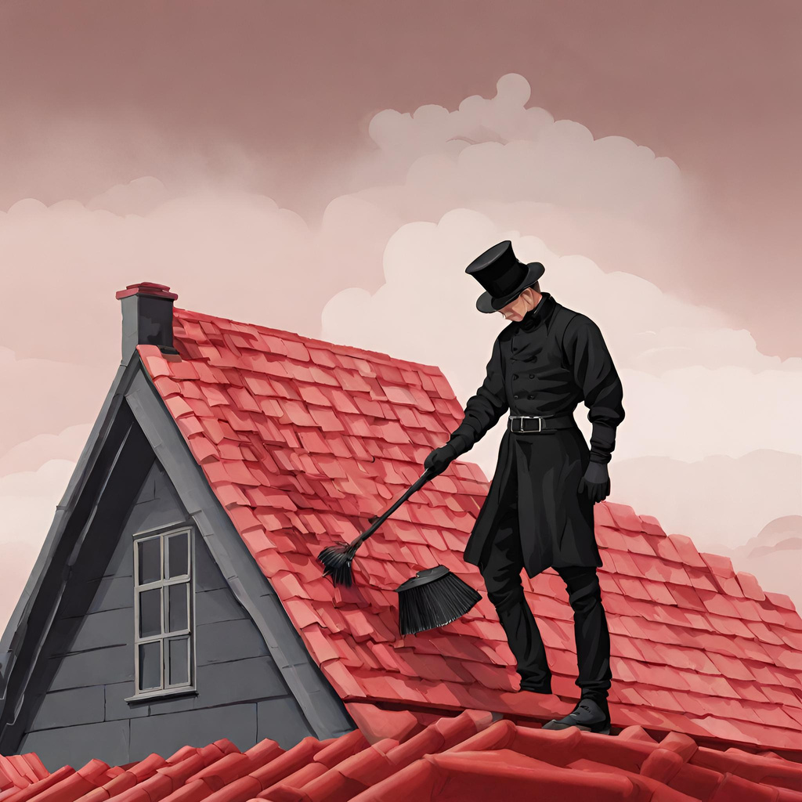
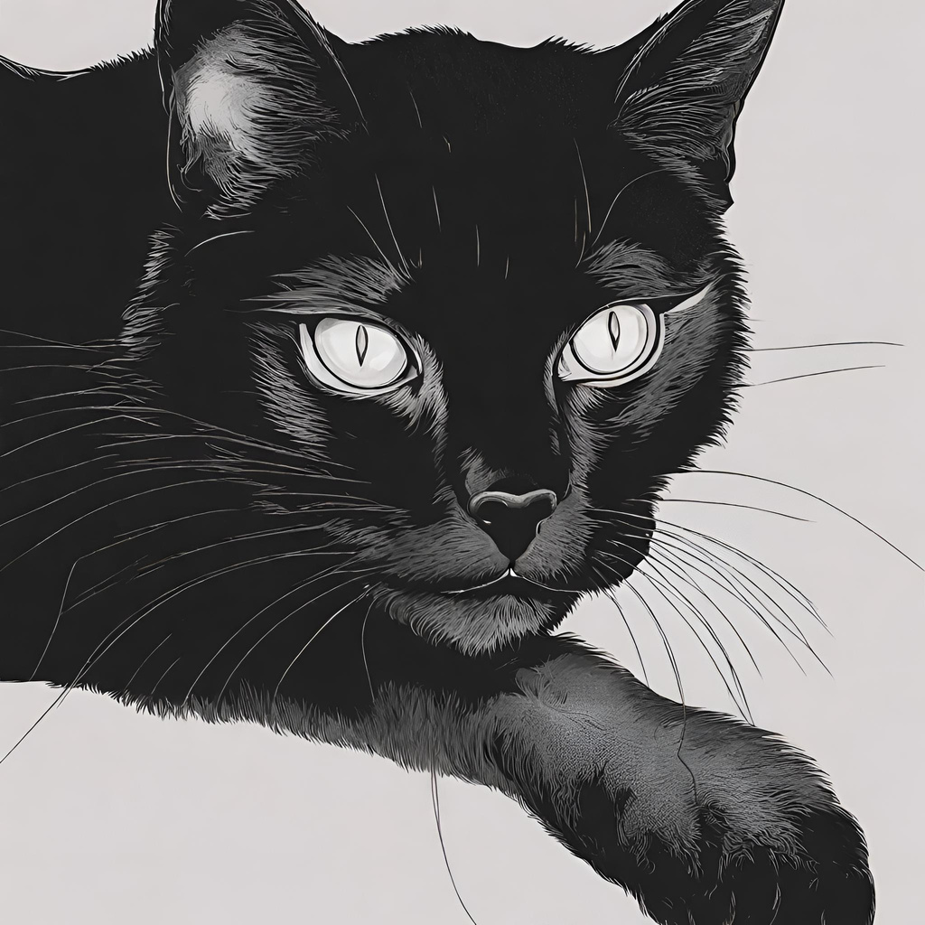
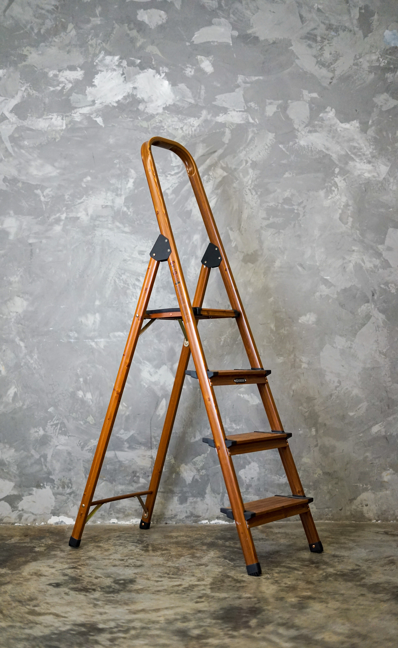
When you see a chimney sweeper, grab the button, it brings good luck
Oh no! you broke a mirror, seven years of bad luck await you
when you see a black cat, you better avoid it, it's bad luck!
did you go under the ladder? Get ready for a dose of bad luck

