Slide 1
Soil Pollution

Slide 2
Soil's meaning for the ecosystem
Soil(also known as earth or dirt) is most essential for plant life, due to its high amounts of valuable minerals and organic matter.
So basically, it's one of the main reasons why plants grow on Earth, so plant-eaters couldn't survive without it.
Soil is also useful for us - humans, because we can farm crops on top of it, which then can be used as a food source.

Slide 3
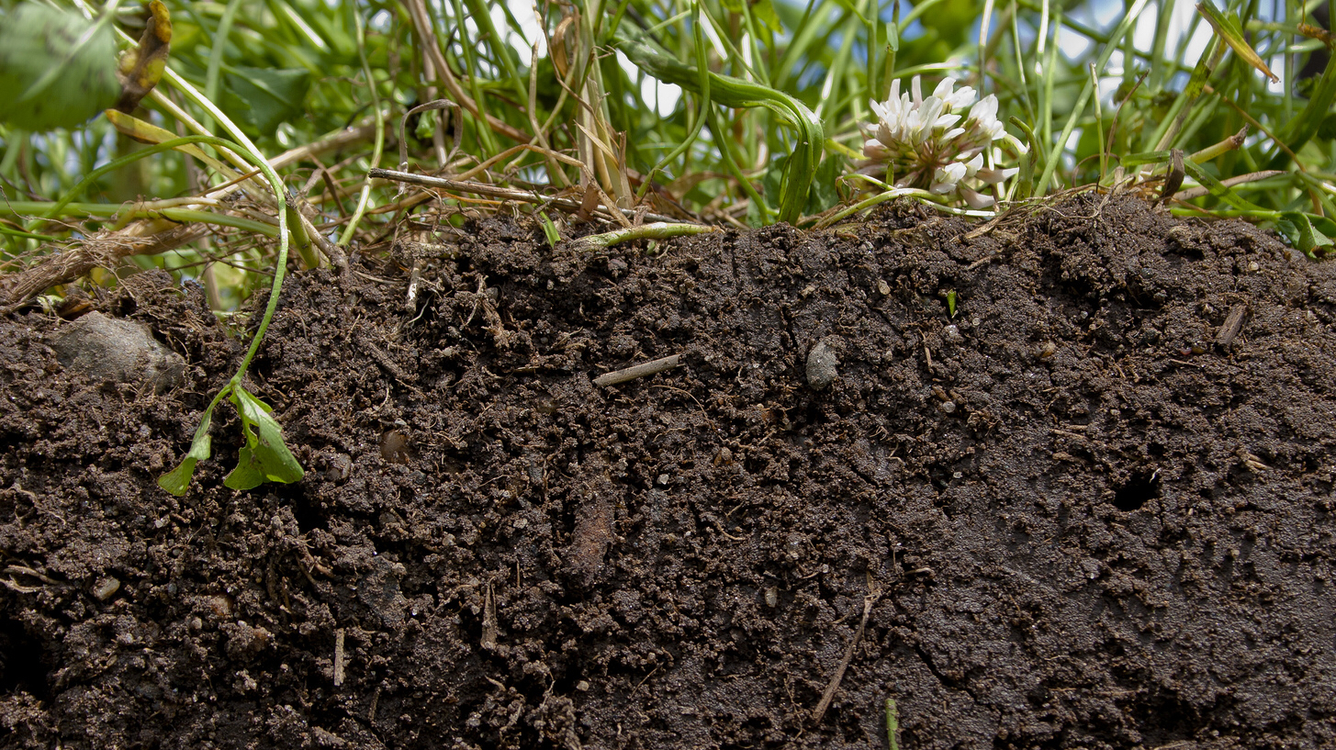
What's humus?
Humus is the dark organic matter in soil that is formed by the decomposition of plant and animal matter. It is a kind of soil organic matter.
Soil's organic matter also consists of roots and small organisms living in the ground.

Slide 4
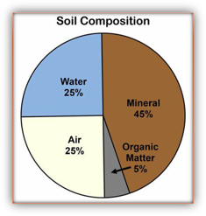
What's soil made of?
As mentioned before, soil consists of many minerals, mainly: potassium, phosphorus and nitrogen gas. There are also some less common minerals, such as: calcium, magnesium and sulfur.
Here's a diagram showing what is soil mainly made of:

Slide 5
What's land degradation?
Land degradation is a process in which the value of the biophysical(natural) environment is affected by a combination of human-induced processes acting upon the land. It is viewed as any change or disturbance to the land perceived to be deleterious or undesirable.

Slide 6
Soil pollution
Soil contamination, soil pollution, or land pollution as a part of land degradation is caused by the presence of human-made chemicals or other alteration in the natural soil environment.

Slide 7
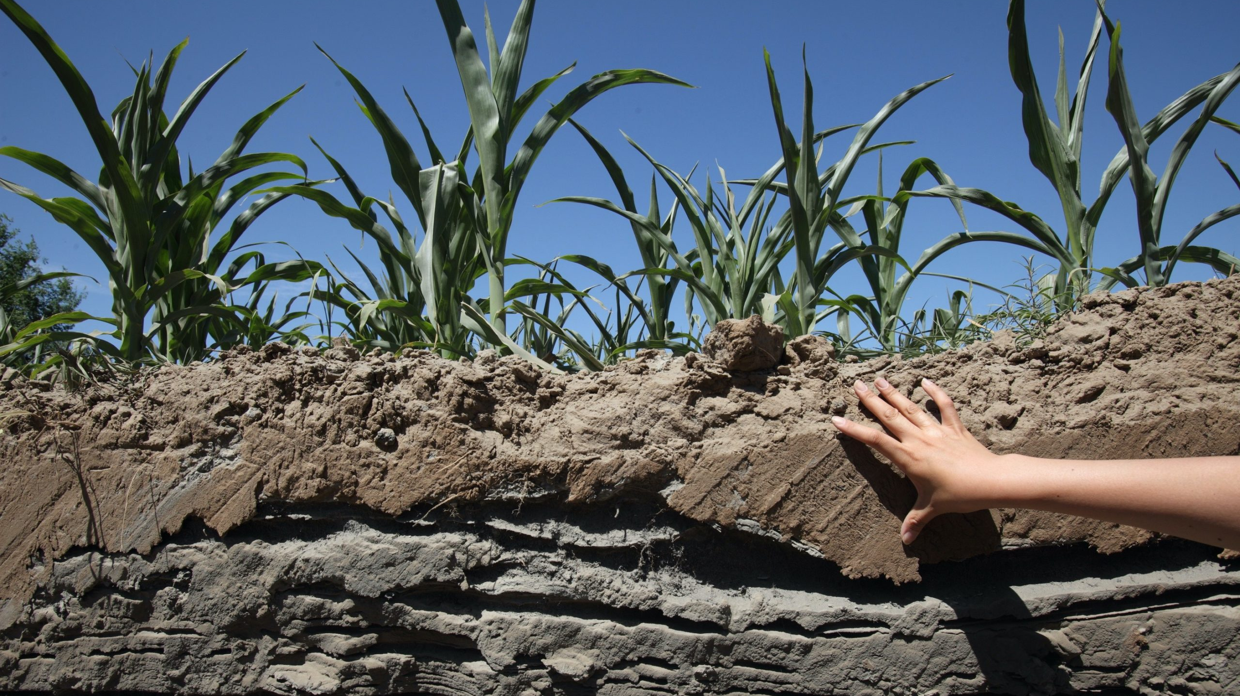
Causes
Transportation activities, releasing toxic vehicle emissions
Mining activities involving the crushing and processing of raw materials, for instance, heavy metals, emitting toxic substances;
Accidental spills and leaks during storage, transport or use of chemicals

Slide 8
Industrial soil pollution
The incorrect way of chemical waste disposal from different types of industries can cause contamination of soil. Human activities like this have led to acidification of soil and contamination due to the disposal of industrial waste, heavy metals, toxic chemicals, dumping oil and fuel, etc.

Slide 9
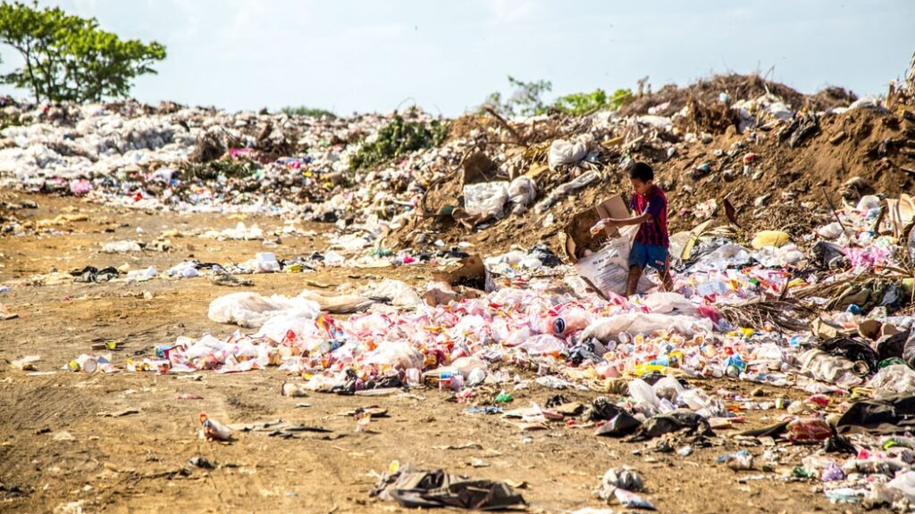
Soil pollution by solid waste
Disposal of plastics, cans, and other solid waste falls into the category of soil pollution. Disposal of electrical goods such as batteries causes an adverse effect on the soil due to the presence of harmful chemicals.

Slide 10
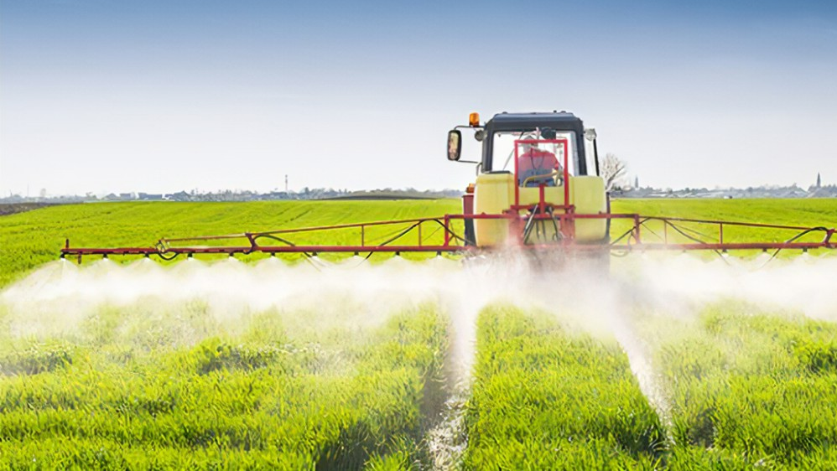
Soil pollution by pesticides
Pesticides are chemicals (or chemical mixes) that are used to kill or prevent pests from reproducing. Due to their exceptional durability, toxicity and high biological activity, pesticides are a serious threat to the natural environment.
This type of soil pollution is common in the region we live in.

Slide 11
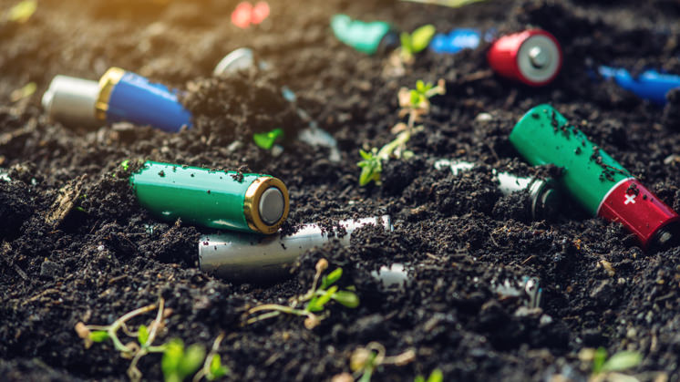
Consequences
Soil pollution affects food security by reducing crop fields and quality. Safe and good quality food can only be produced if our soils are healthy. Without healthy soils, we won’t be able to end the world hunger
Pollution of soil also damages our health Soil pollutants enter our body through the food chain, causing illnesses to appear.
Soil degradation affects the quality of air and water, particularly in developing countries.

Slide 12
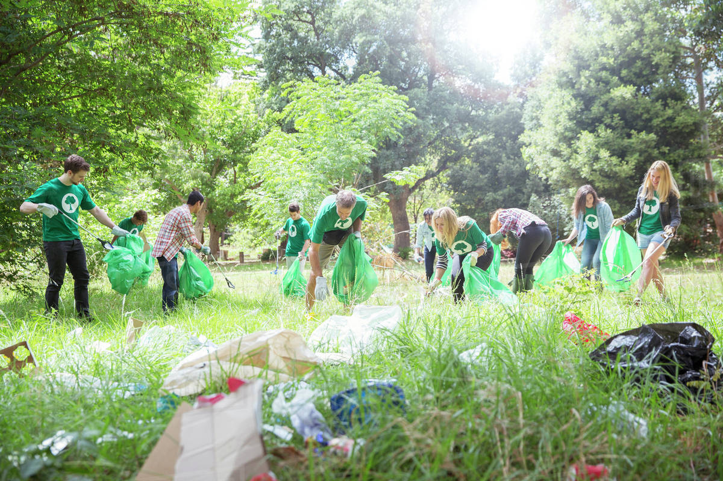
Prevention
To prevent soil pollution:
Don't litter, pick up garbage
Correctly dispose wastes, recycle trash
Use organic fertilizers, not pesticides
Other eco-friendly activities, such as avoid plastic usage, or composting organic food, will also help preventing soil pollution.

Slide 13
The End
z

