Slide 1
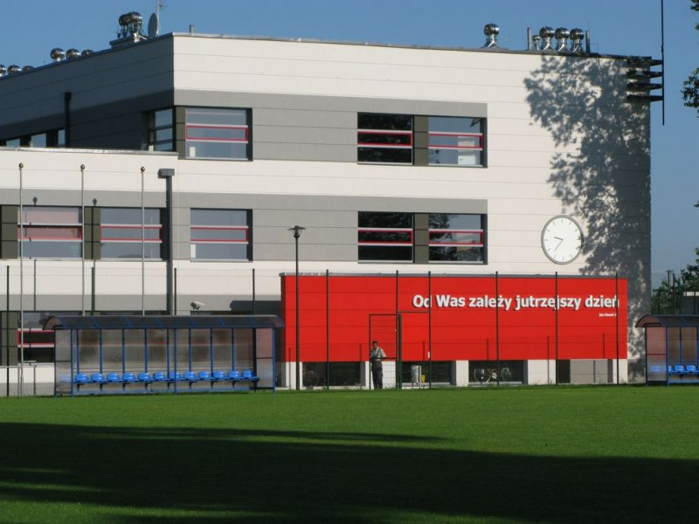
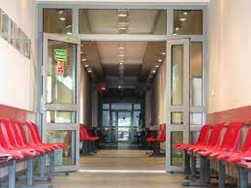
The Primary School of Adam Mickiewicz in Żyrzyn by Ala Bakiera, Lena Tadrjan and Julia Ciuba
.

Slide 2
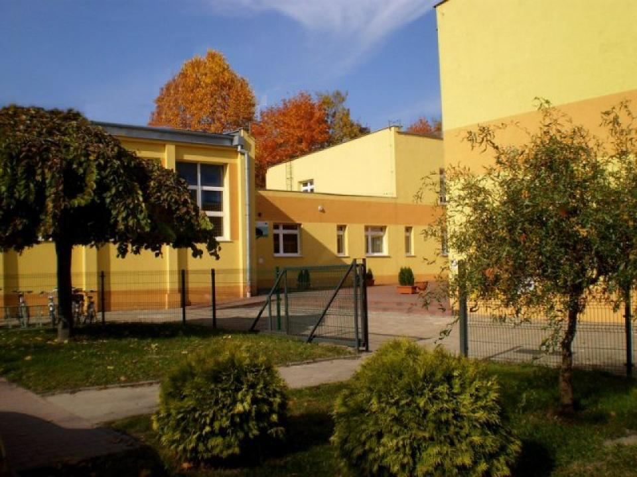
Primary School of Adam Mickiewicz in Żyrzyn is an eight-year primary school. The housing base is a building from the 1960s and a modern one - a former gymnasium.

Slide 3
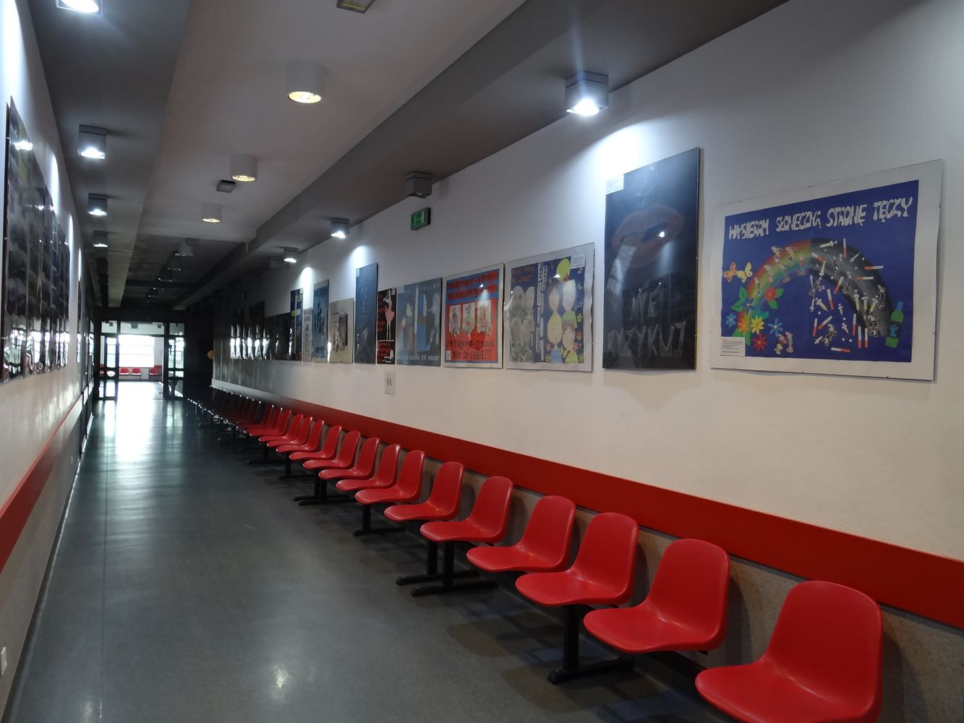
In our school we have a cloakroom with lockers and long corridors with chairs.

Slide 4
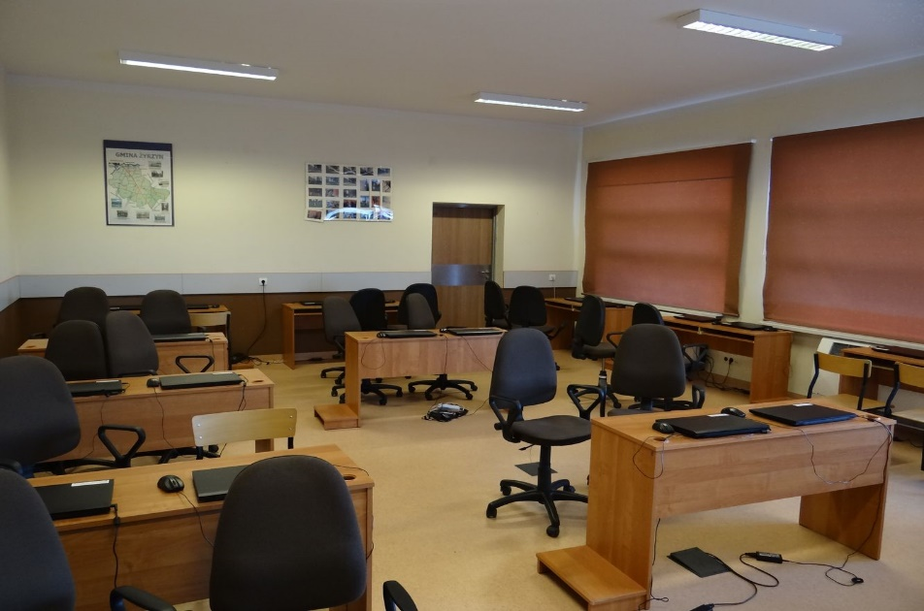
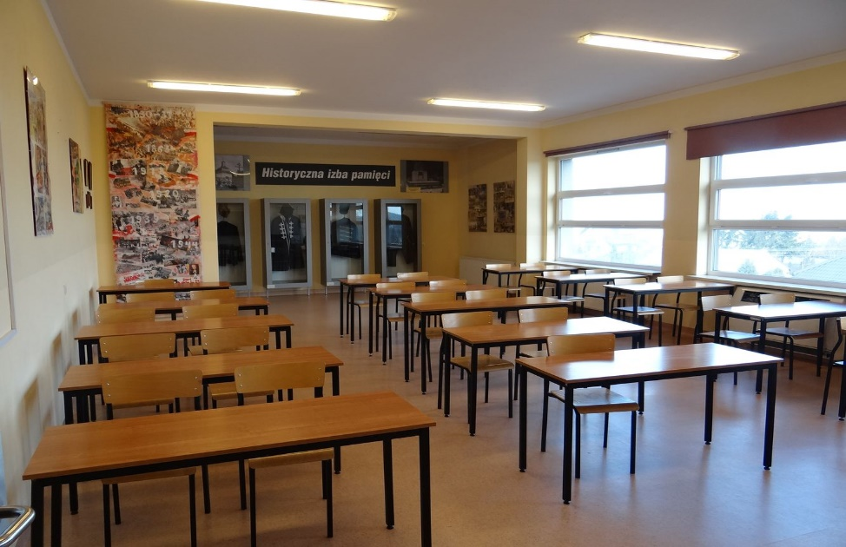
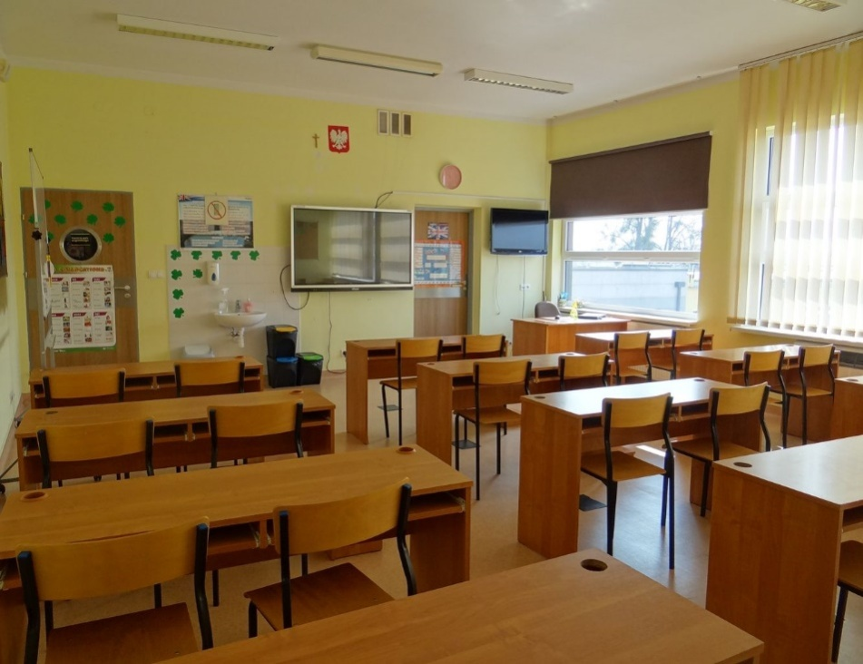
These are our 3 favourite class rooms: IT lab, history classroom and English classroom.

Slide 5
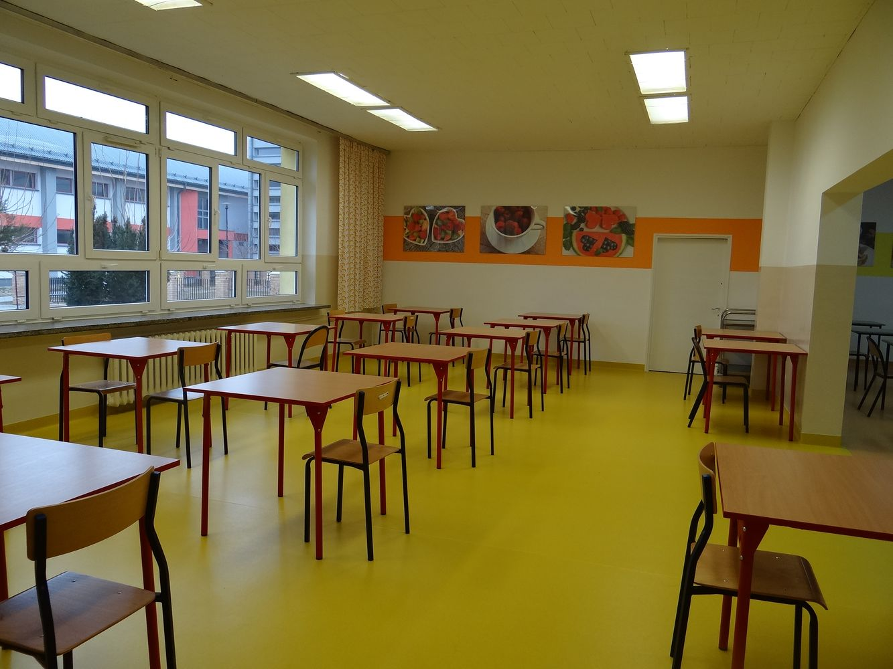
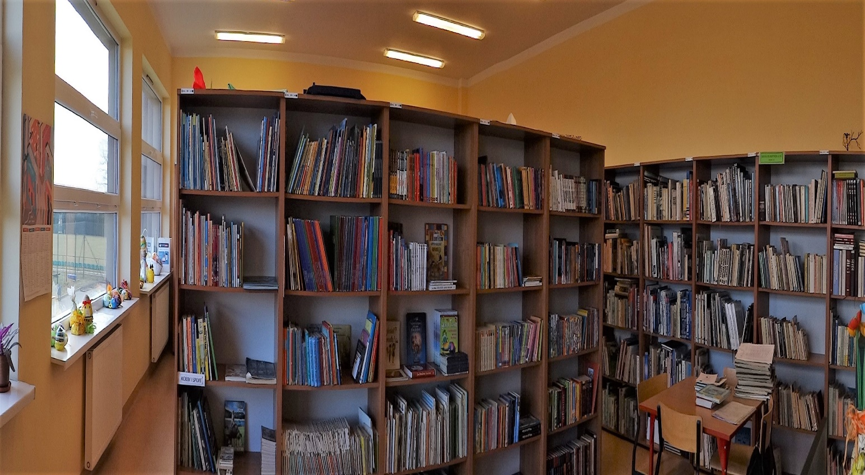
In our school we also have a canteen and a library.

Slide 6
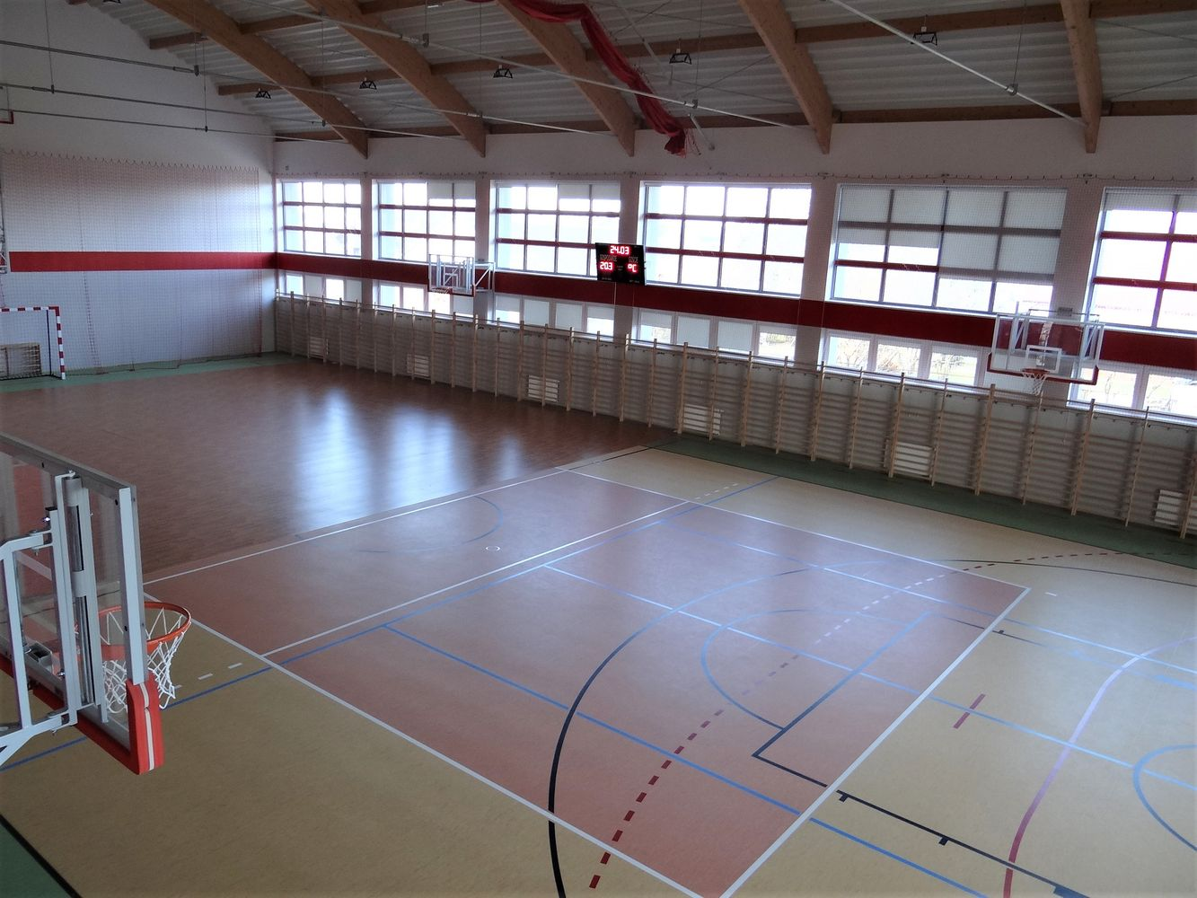
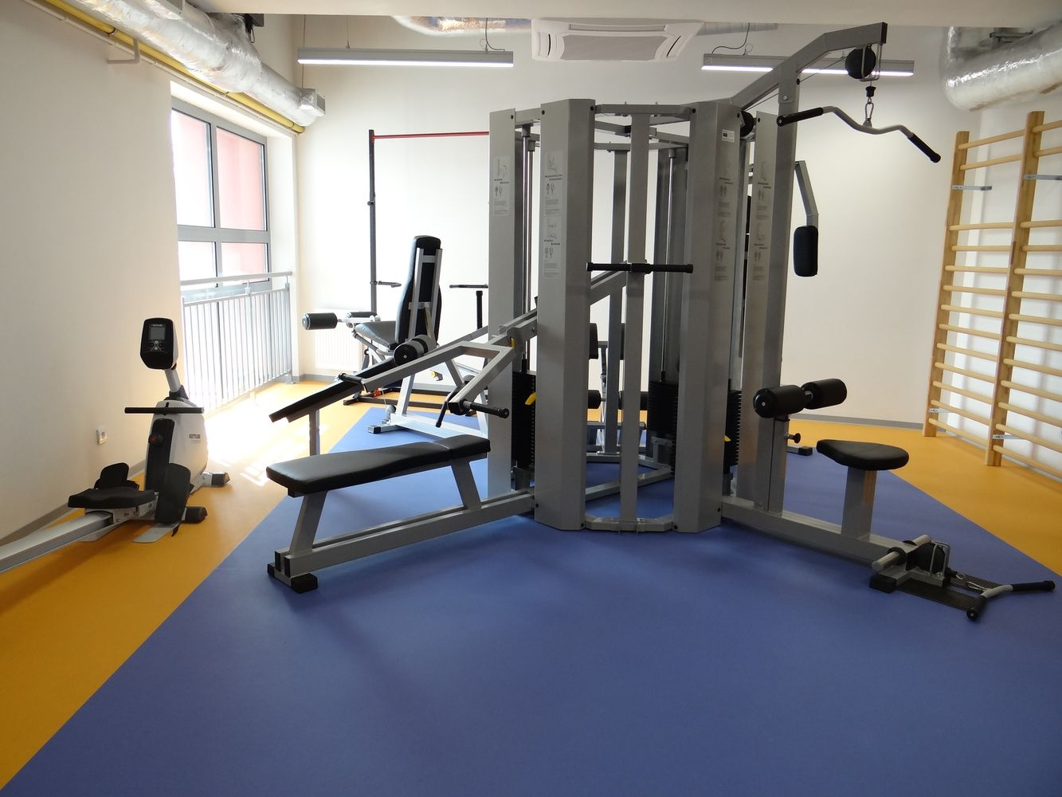
Recently, a modern sports hall and gym were also built.

Slide 7
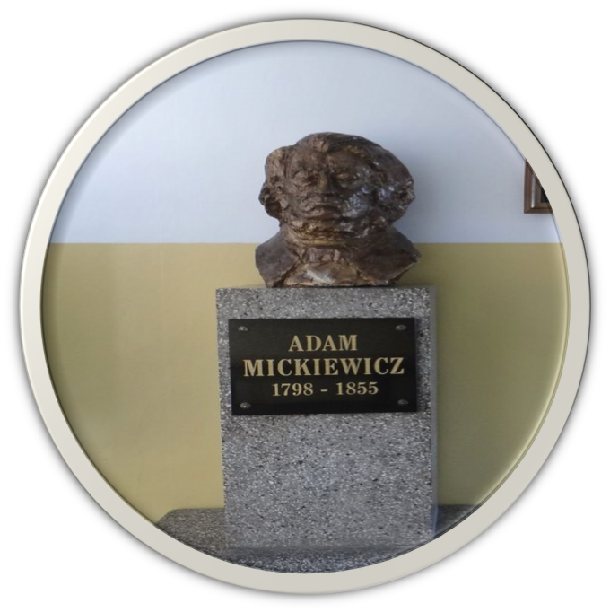
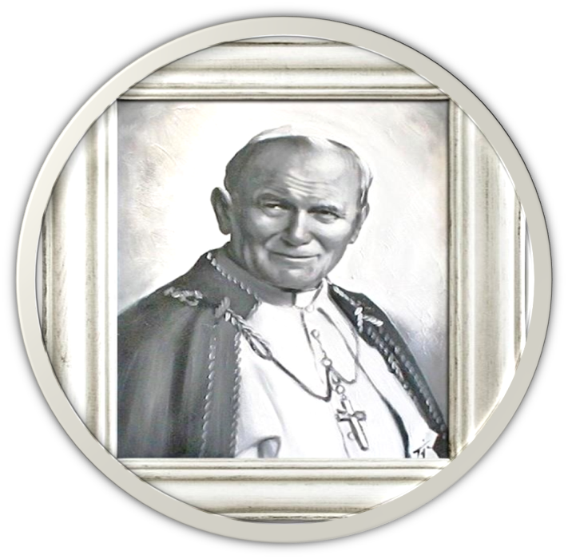
Adam Mickiewicz is the patron of our school, and John Paul II is the patron of the former gymnasium.

Slide 8
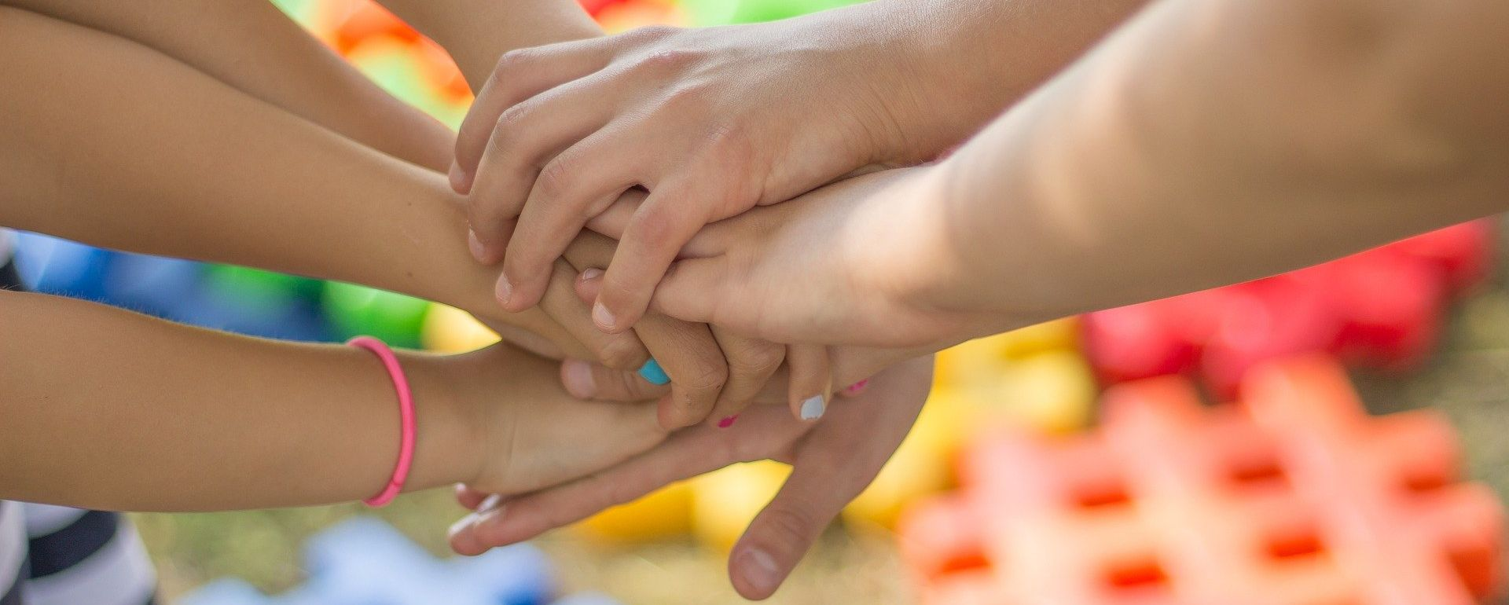
Our school is a safe place. It has a warm and friendly atmosphere for everyone.

